Slide 1
Bicycle Hire Planner
“It’s Not a Bug It’s a feature” Client Meeting Three

Slide 2
User Stories and Epics Update

Slide 3


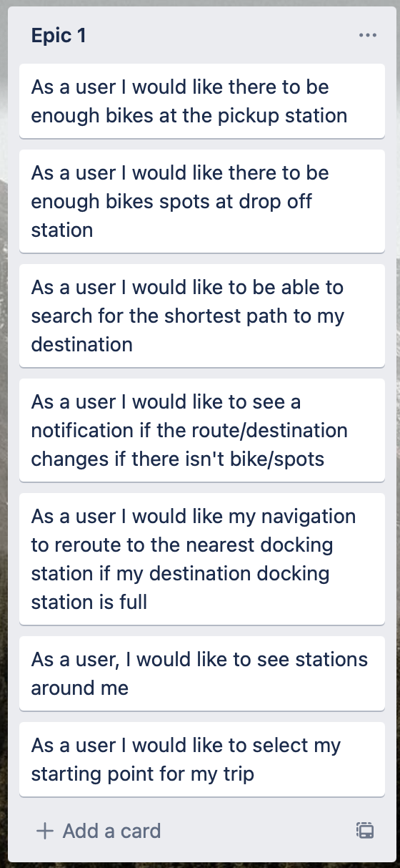
Epic one Remainder
Complete

Slide 4
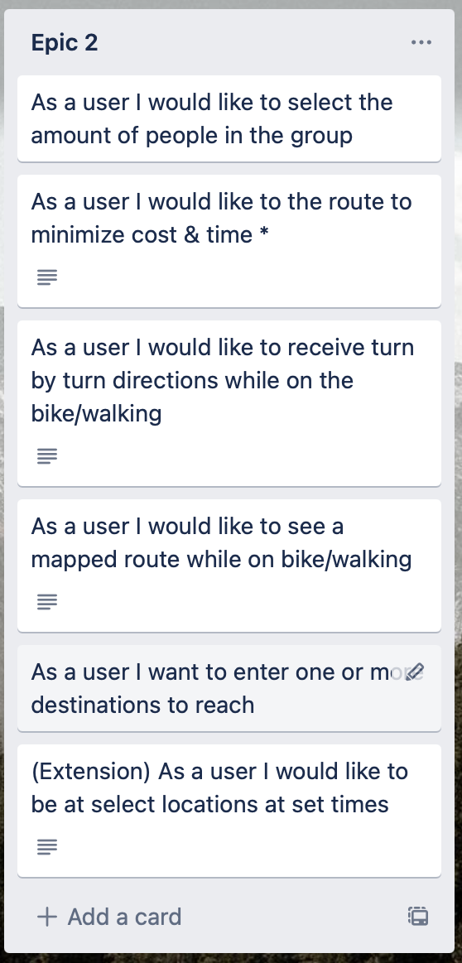
Epic Two Remainder
Minimize Cost Route
On Schedule to be complete Tuesday

Slide 5
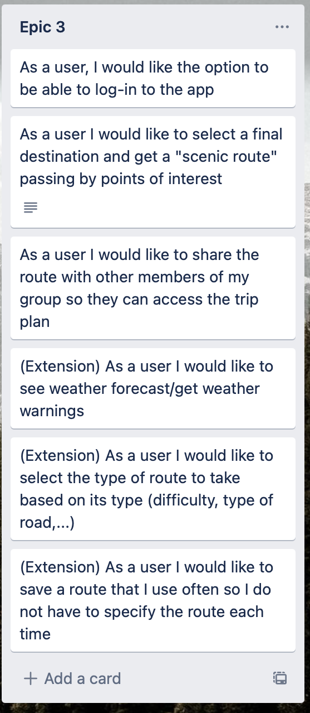
Epic Three
Favorite Station, Favorite Route, Past Route
On Schedule to be Complete Tuesday
Log In Complete
Weather Complete
Ease of Use Extension Complete
Informational Pop up/Choice Box on certain actions

Slide 6
Client Requests
Only Load Stations Near You Complete
Two Options for Routing When Not at Start Location Complete
Minimize Route Card when Pressed Off Complete
Orientate Camera to Align with Polyline (Instead of User Direction)
On Track for Tuesday

Slide 7
App Video Tour & Client Hands-On
Any Input or Suggested Changes

Slide 8
Project Timeline
Week March 15th – March 22nd
Start Project Report (Manual Testing Report Complete)
Logged in Extension (On Track)
Code Refactor (On Track)
Week March 22nd – April 1st
Extend Automated Testing Suite (Currently 50% Coverage)
Final Bug Fixes/Tweaks
Finalize Deployment
Will Deliver as .apk & .app
Finalize Report

